Slide 1



Slide 2












Slide 3

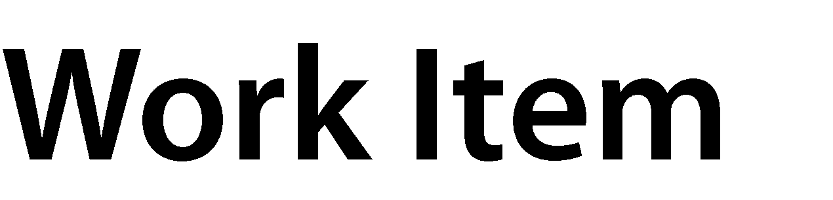




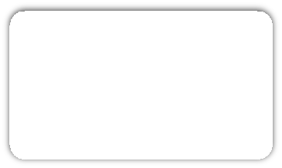


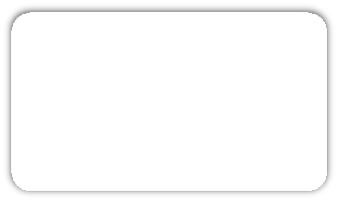











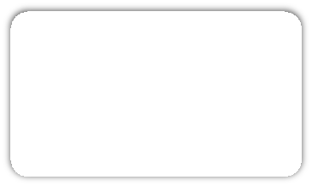
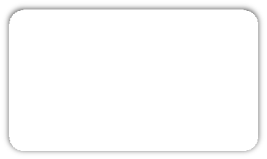







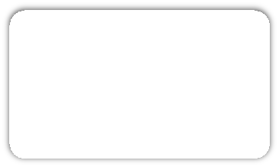
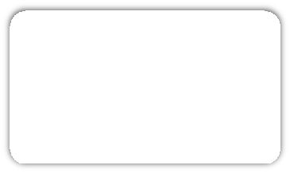


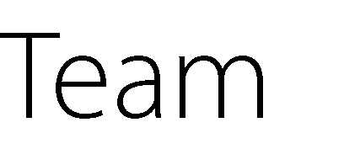







Slide 4
public void Delete()
{
switch (this.State)
{
case "Proposed": unitOfWork.Entities.Remove(this); break;
case "Active":
Console.WriteLine("Work Item is already active. Cannot Delete."); break;
case "Resolved":
Console.WriteLine("Work Item is already resolved. Cannot Delete."); break;
case "Closed": unitOfWork.Entities.Remove(this); break;
}
}

Slide 5

















Slide 6



Slide 7

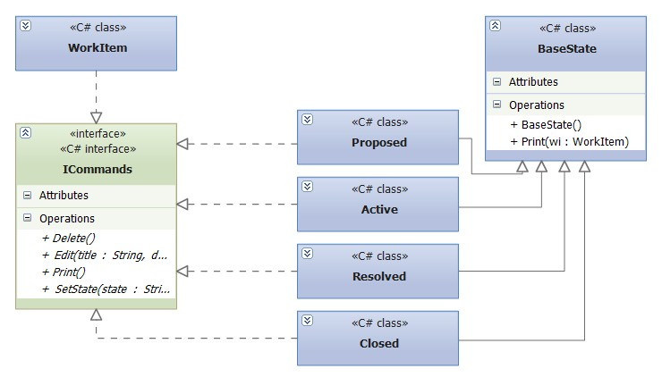

Slide 8
interface ICommands
{
void Delete();
void Edit(string title, string desc);
void Print();
void SetState(string state);
}

Slide 9








▪
▪
▪
▪
▪
▪

Slide 10

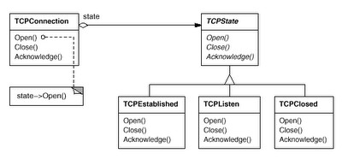








▪
▪
▪

Slide 11


▪
▪
▪
▪
▪

